Slide 1
Leveraging Traffic Repetitions for High-Speed Deep Packet Inspection
Author: Anat Bremler-Barr, Shimrit Tzur David, Yotam Harchol, David Hay
Publisher: IEEE INFOCOM 2015
Presenter: Sih-An Pan
Date: 2015/1/7
Department of Computer Science and Information Engineering
National Cheng Kung University, Taiwan R.O.C.
Notes:
1

Slide 2
INTRODUCTION
Our mechanism is based solely on modifications to the signature matching algorithm.
Our modification enhances the algorithm so that it will be able to skip previously-scanned bytes, which are saved in a dictionary along with some auxiliary information.

Slide 3
INTRODUCTION
Conceptually, it is divided to two parts:
slow path that samples the traffic and creates a dictionary with the fixed length popular strings (which we call grams).
data path that scans the traffic byte by byte and checks the dictionary for matches; if a gram is found in the dictionary, the data path skips the gram and adjusts its state according to an information saved along this gram.

Slide 4
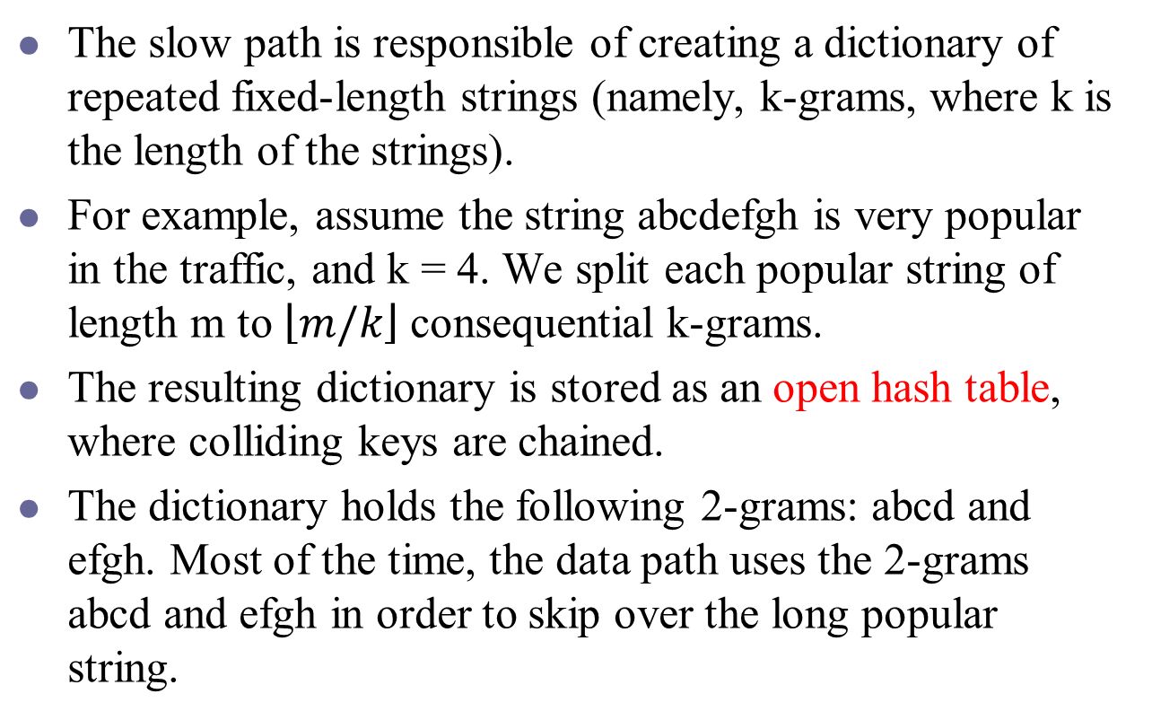
The Slow Path
The slow path is responsible of creating a dictionary of repeated fixed-length strings (namely, k-grams, where k is the length of the strings).
For example, assume the string abcdefgh is very popular in the traffic, and k = 4. We split each popular string of length m to $\left\lfloor m/k\right\rfloor$ consequential k-grams.
The resulting dictionary is stored as an open hash table, where colliding keys are chained.
The dictionary holds the following 2-grams: abcd and efgh. Most of the time, the data path uses the 2-grams abcd and efgh in order to skip over the long popular string.

Slide 5
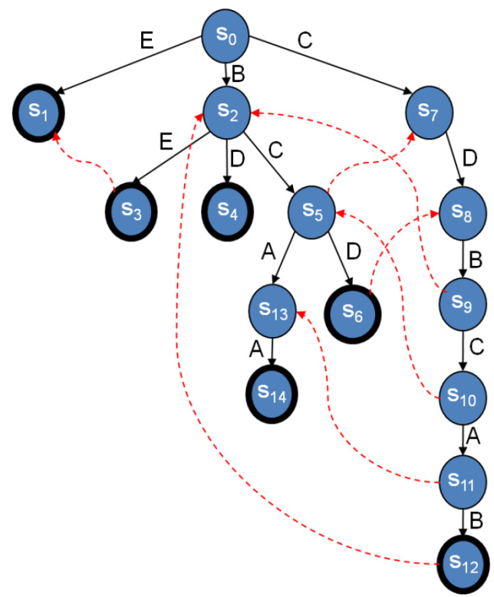
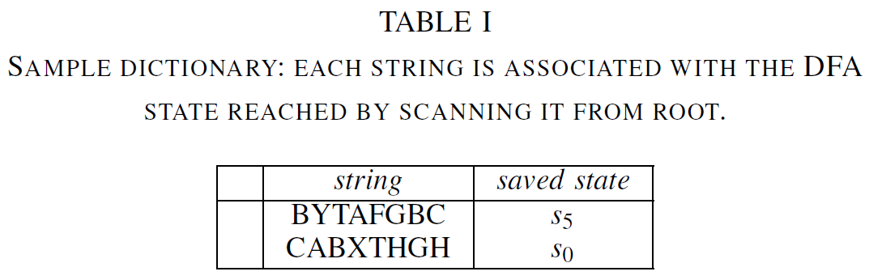
The Slow Path
We initiate an Aho-Corasick scan from the initial state s0 and save the DFA state in the end of this scan.
This information is sufficient for the data path to adjust its state after skipping that gram.

Slide 6
The Data Path
For each k-gram, the algorithm searches the dictionary and retrieves the corresponded entry.
We query a Bloom filter to ensure that the gram is in the dictionary.
During AC traversal, for each input byte, the algorithm checks whether it can skip subsequent bytes using one of the strings in the dictionary.

Slide 7
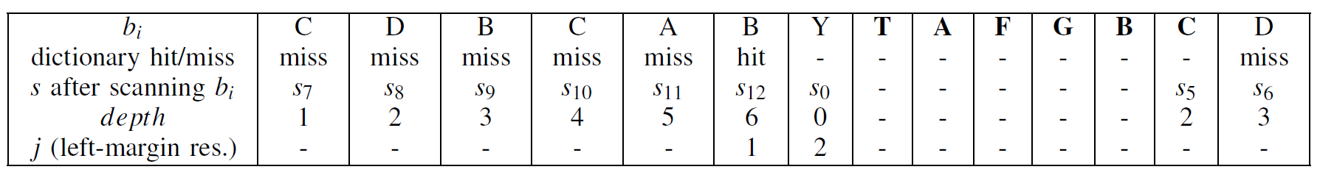
The Data Path

Slide 8
The Data Path

Slide 9
The Data Path

Slide 10
The Data Path

Slide 11
The Data Path

Slide 12
The Data Path

Slide 13
EXPERIMENTAL RESULTS
For HTTP traffic, we use Snort’s pattern-set (~4K patterns).
For performance evaluation we use a system with Intel Sandybridge Core i7 2600 CPU with 32 KB L1 data cache (per core), 256 KB L2 cache (per core), and 8 MB L3 cache (shared among cores). The system runs Linux Ubuntu 11.10.

Slide 14
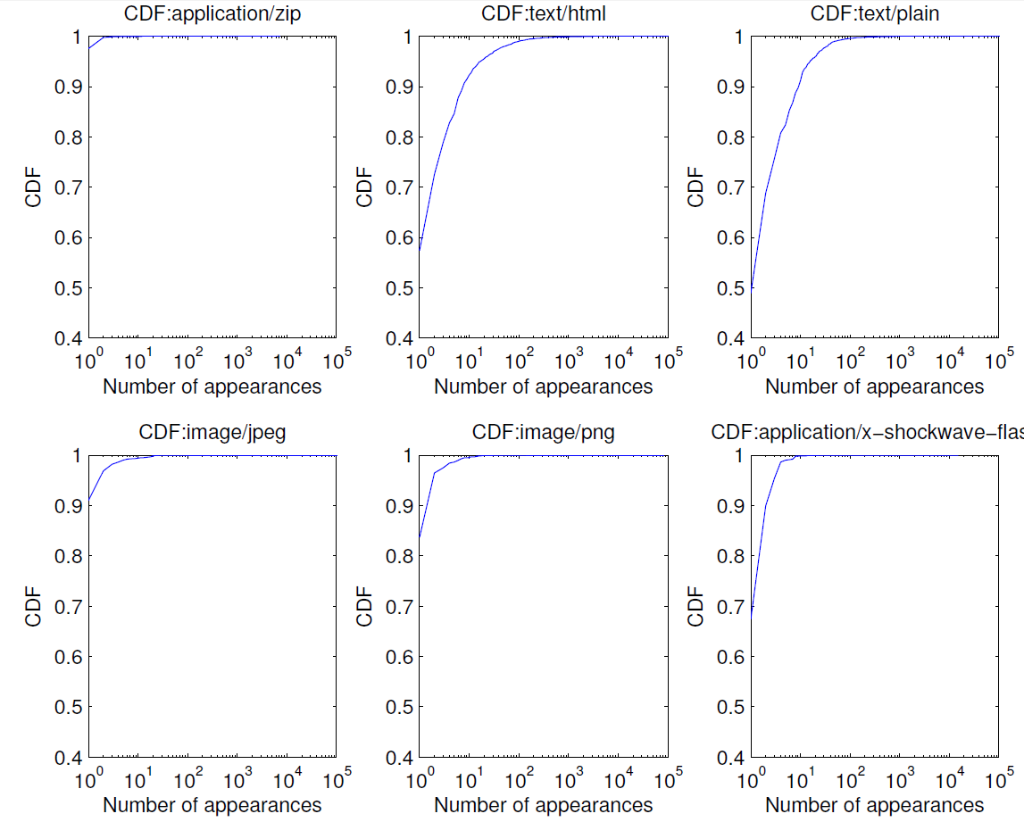
EXPERIMENTAL RESULTS

Slide 15
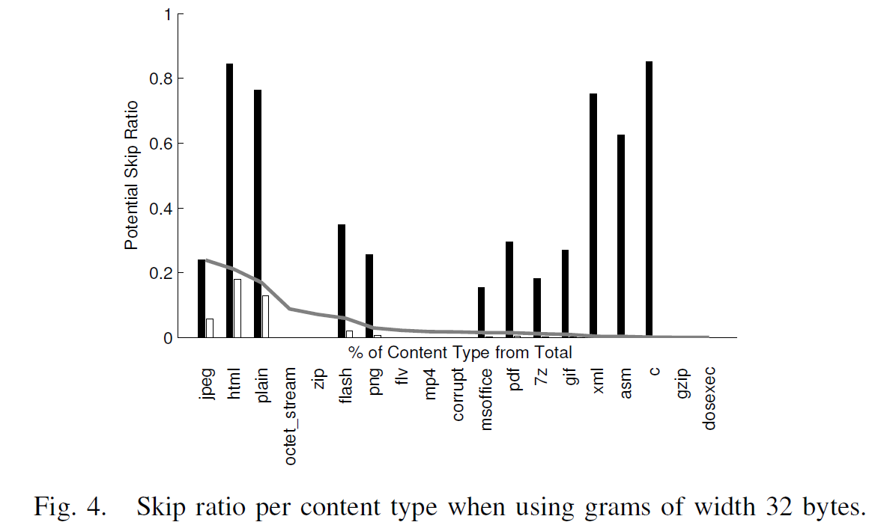
EXPERIMENTAL RESULTS

Slide 16
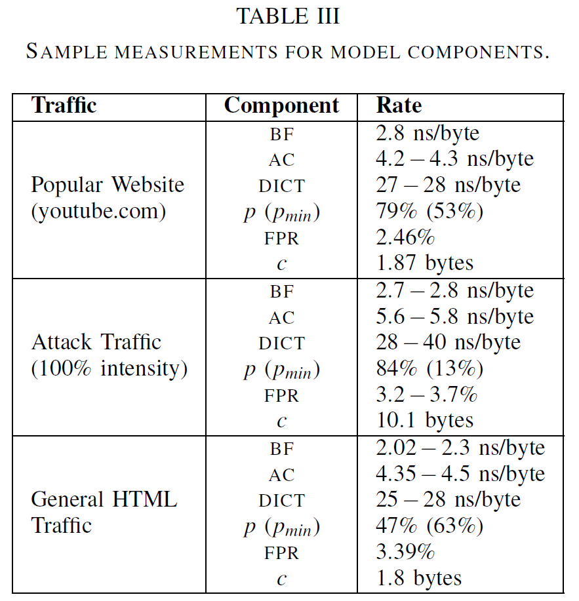
EXPERIMENTAL RESULTS

Slide 17
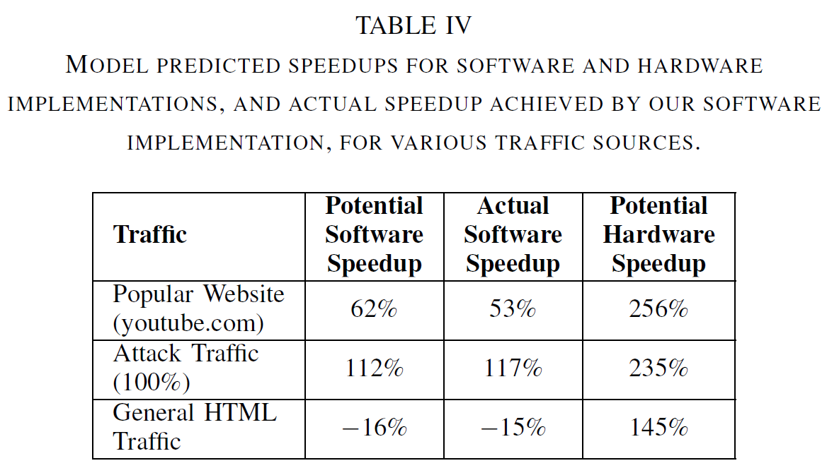
EXPERIMENTAL RESULTS

Slide 18
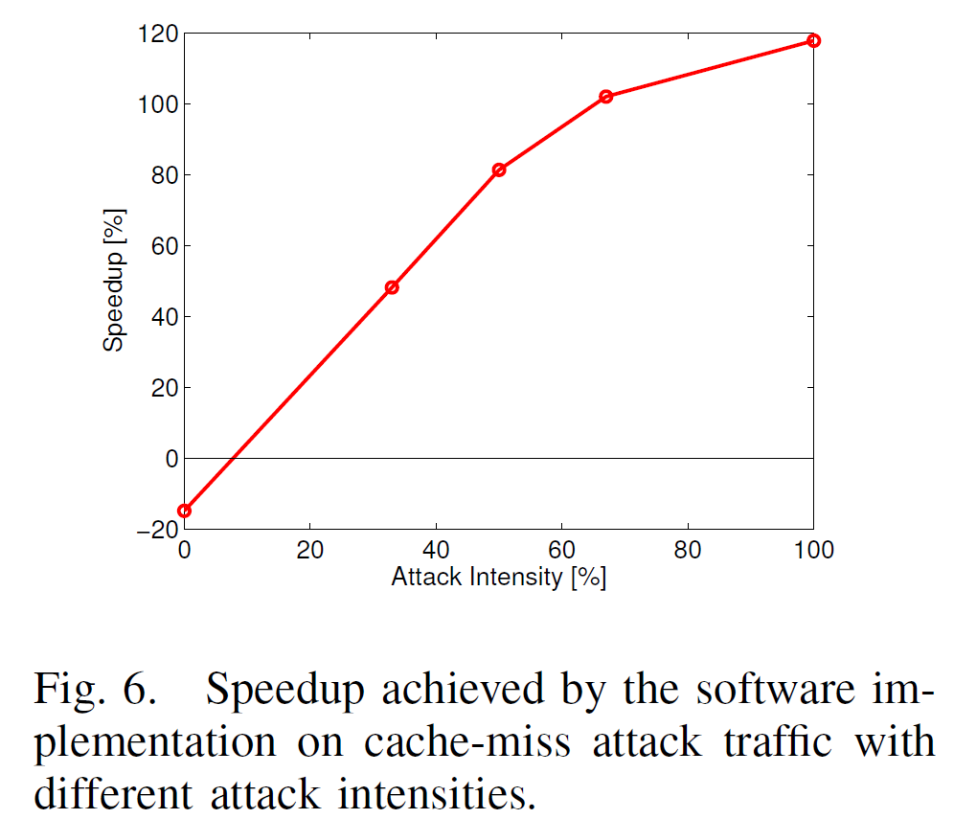
EXPERIMENTAL RESULTS

Slide 19
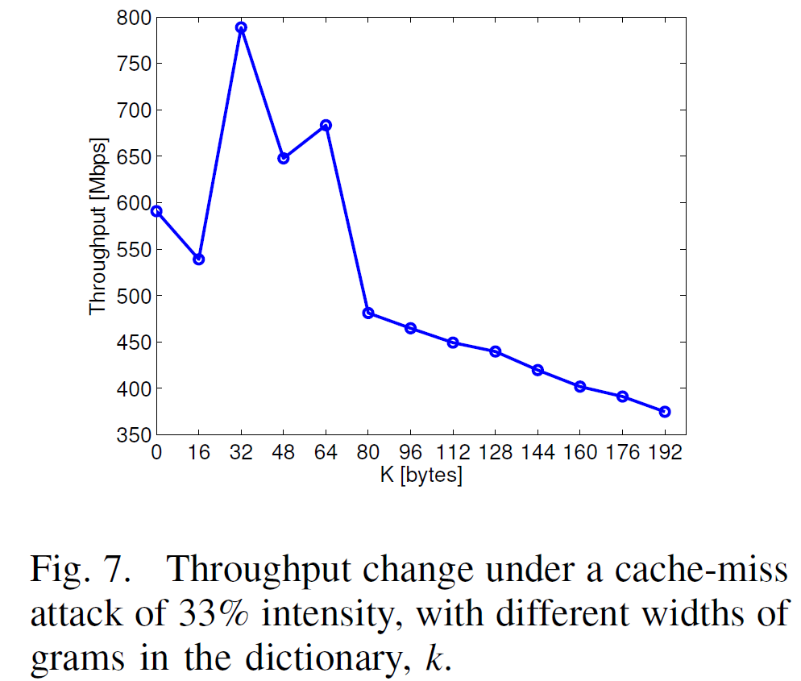
EXPERIMENTAL RESULTS

Slide 20
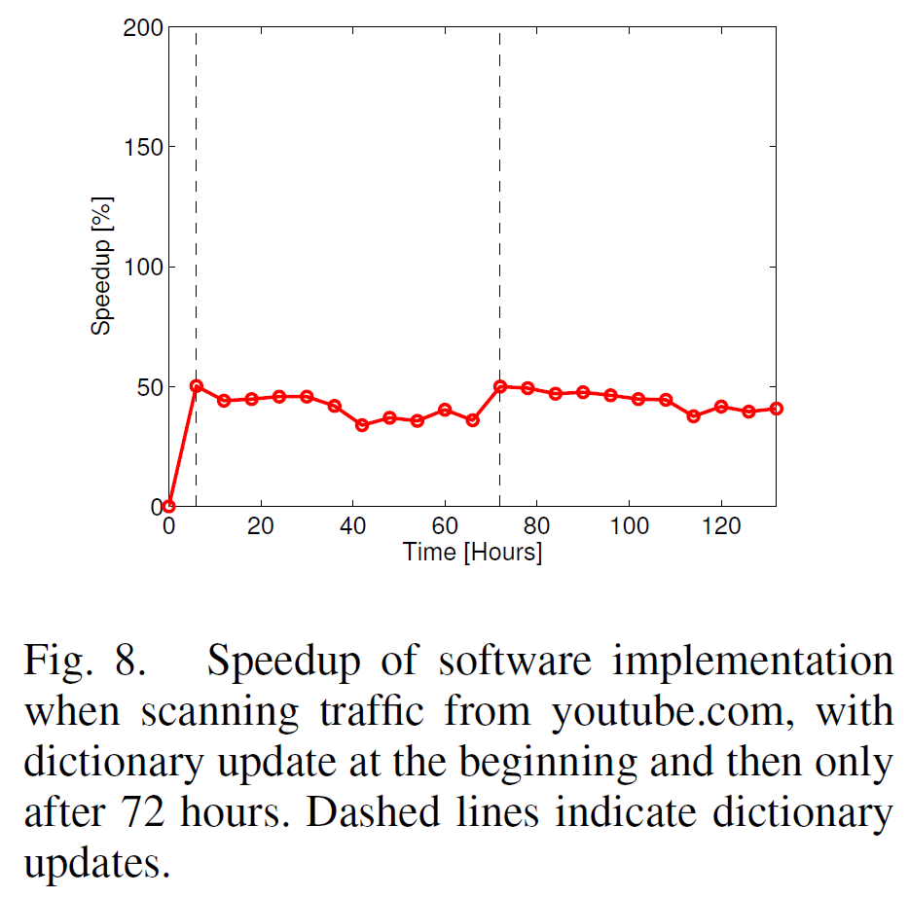
EXPERIMENTAL RESULTS

